Slide 1
Artificial intelligence
Prepared by : Ifra fazal (2022-cs-194)

Slide 2
Data Preprocessing
What is Data Preprocessing?
Definition: Data preprocessing involves cleaning and transforming raw data into a usable format.
Goal: To improve data quality for analysis or model training.

Slide 3
Why is Data Preprocessing Necessary?
Accuracy: Raw data may contain errors or inconsistencies, leading to inaccurate predictions.
Efficiency: Cleaned data helps models learn faster and more effectively.
Consistency: Ensures all data features are on the same scale and format.

Slide 4
Types of Data Preprocessing
Feature Selection
Removing irrelevant or redundant features
Feature Engineering
Creating new features
Data Transformation
Discretization (Binning)
Dividing continuous features into discrete bins
Data Augmentation
Synthetic data creation
Handling Missing Data
Imputation (filling missing values)
Dropping missing data
Normalization and Scaling
Min-Max Scaling
Standardization (Z-score scaling)
Feature Encoding
One-Hot Encoding
Label Encoding

Slide 5
Handling Missing Data
Imputation
Dropping Missing Values
Interpolation

Slide 6
Dropping missing values
Removing rows or columns with missing values.
#drop cabin
df = df.drop('Cabin', axis=1)

Slide 7
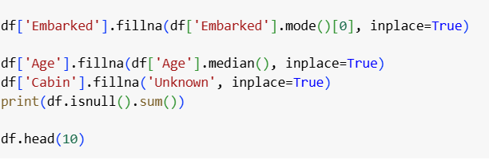
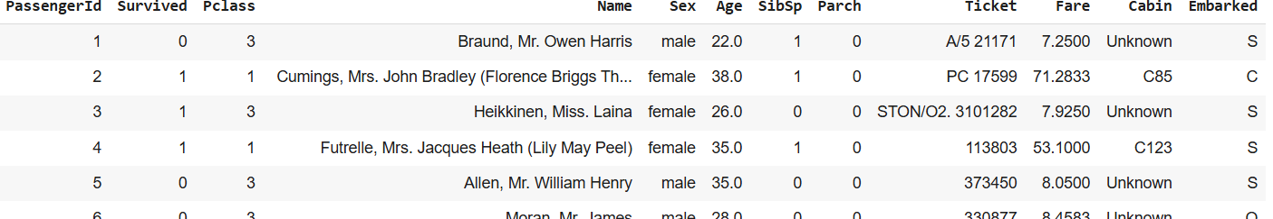
Imputation
Filling in missing values using mean, median, mode, or other values.

Slide 8
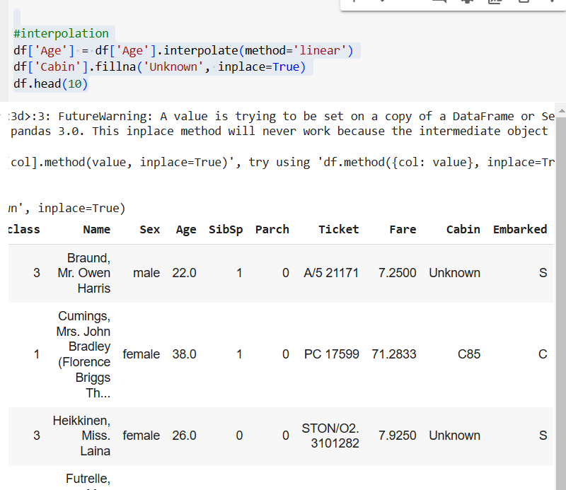
Interpolation
Estimating missing values using nearby data points..

Slide 9
Data Cleaning
Dropping Duplicate Values
df.drop_duplicates(inplace=True)
df.head()

Slide 10
Data Transformation
Scaling
Standardization (Z-score Normalization): Scaling features to have zero mean and unit variance.
Min-Max Scaling: Scaling features to a specific range, typically [0, 1].
Normalization: Scaling each row so that the feature vector has unit norm.

Slide 11
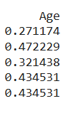
Normalization
from sklearn.preprocessing import MinMaxScaler
scaler = MinMaxScaler()
df['Age'] = scaler.fit_transform(df[['Age']])
print(df.head())

Slide 12

Scaling
from sklearn.preprocessing import StandardScaler
scaler = StandardScaler()
df['Fare'] = scaler.fit_transform(df[['Fare']])
print(df.head())

Slide 13
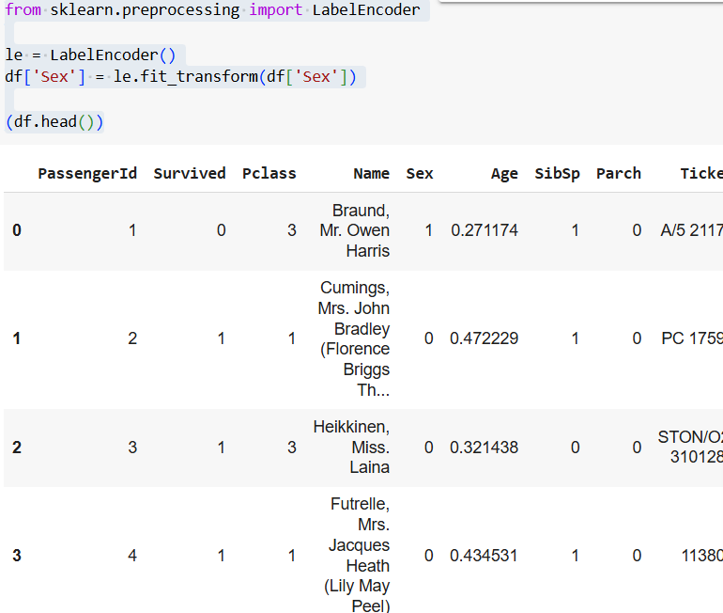
Transforming Categorial Data
from sklearn.preprocessing import LabelEncoder
le = LabelEncoder()
df['Sex'] = le.fit_transform(df['Sex'])
(df.head())

Slide 14
Feature Engineering
Polynomial Features: Generating new features by calculating polynomial combinations.
Interaction Features: Combining features to create new ones.
Discretization (Binning): Converting continuous data into discrete bins.
Log Transformation: Applying a log transform to reduce skewness.

Slide 15
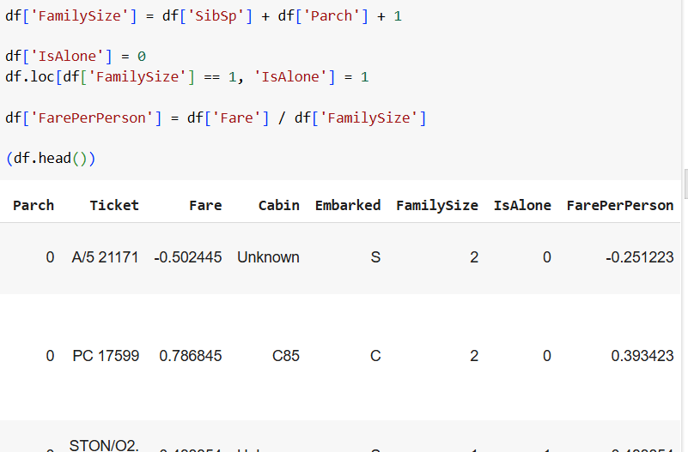
Feature Engineering
Interaction Features

Slide 16
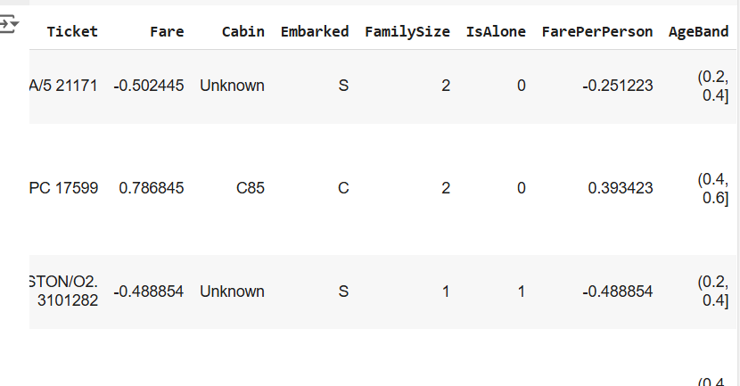
Feature Engineering
Binning
df['AgeBand'] = pd.cut(df['Age'], 5)

Slide 17

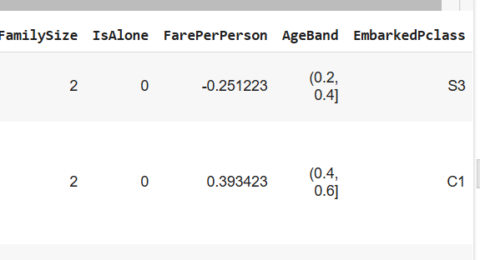
Data Integration
Combining different columns and datasets.

Slide 18
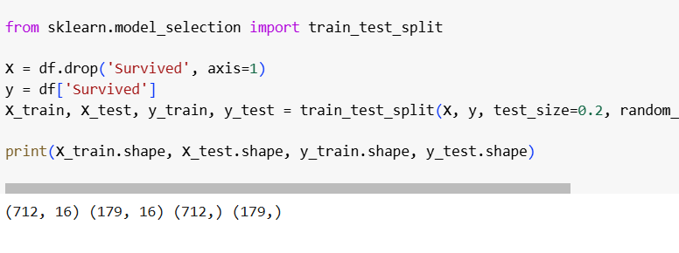
Splittin the Dataset
For training and testing of our model we split the dataset.

Slide 19
Data augmentation

Slide 20
Data AUGMENTATION
What is Data Augmentation?
Definition: A technique to increase the size of the dataset by creating modified versions of existing data.
Purpose: To improve model generalization and prevent overfitting

Slide 21
Data AUGMENTATION Techniques
Image Augmentation: Rotation, flipping, scaling, and zooming.
Text Augmentation: Synonym replacement, sentence restructuring.
Tabular Augmentation: Generating new rows based on existing data through slight modifications

Slide 22
Data AUGMENTATION Techniques
Image Augmentation: Rotation, flipping, scaling, and zooming.

Slide 23

Data AUGMENTATION Techniques
Image Augmentation: Rotation, flipping, scaling, and zooming.
SAMPLE IMAGE :

Slide 24
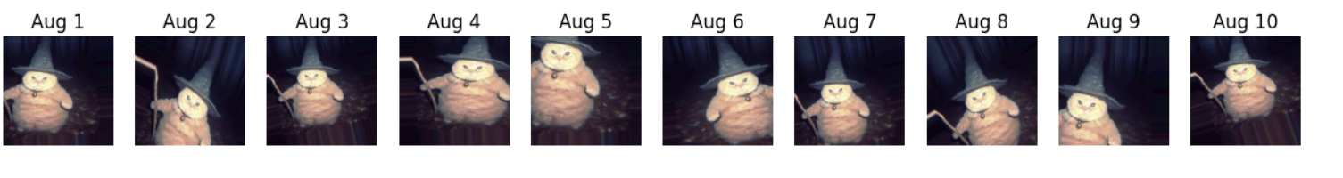
Data AUGMENTATION Techniques
Image Augmentation: Rotation, flipping, scaling, and zooming.
AUGMENTED IMAGES :

Slide 25
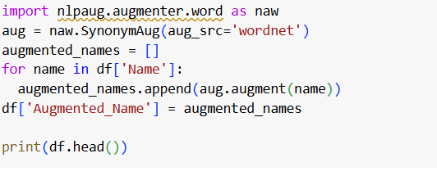
Data AUGMENTATION Techniques
Text Augmentation: Synonym replacement, sentence restructuring.

Slide 26
Data AUGMENTATION Techniques
Text Augmentation: Synonym replacement, sentence restructuring.

Slide 27
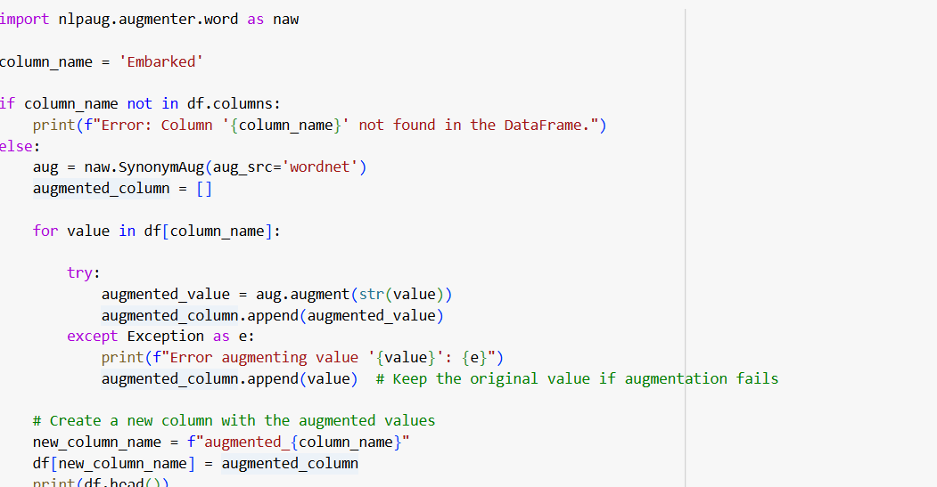
Data AUGMENTATION Techniques
Tabular Augmentation: Generating new rows based on existing data through slight modifications

Slide 28
Visualization

Slide 29
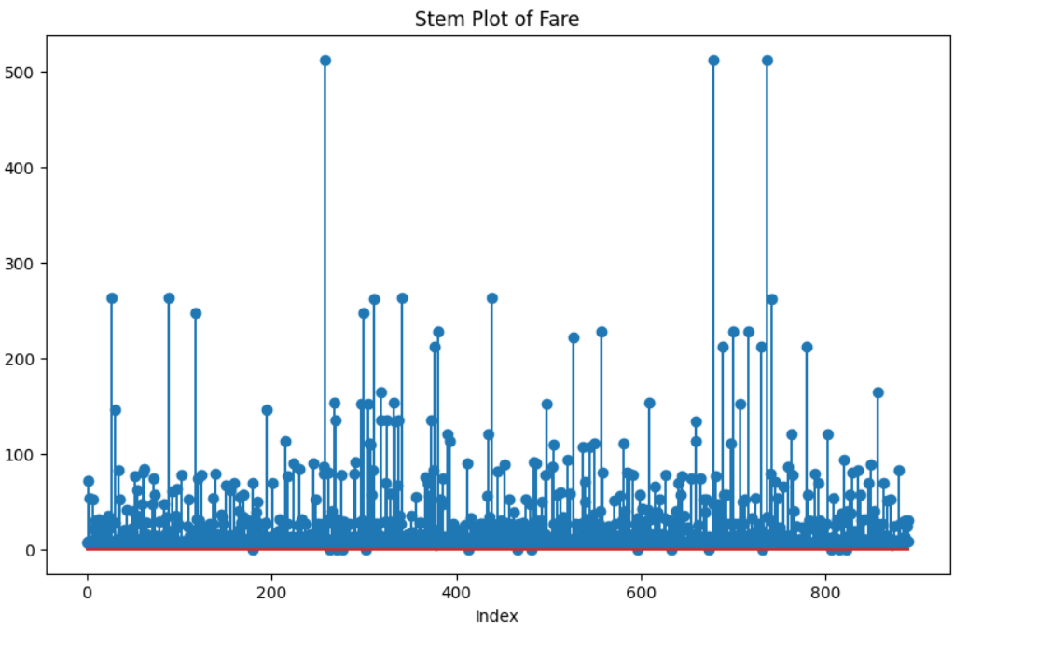
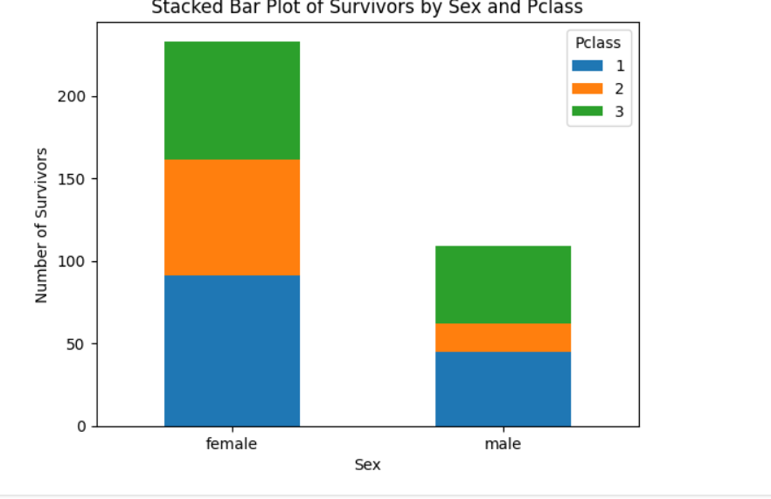

Slide 30
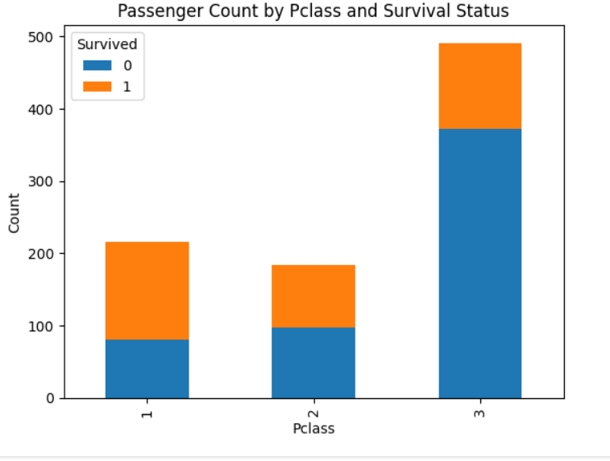

Slide 31
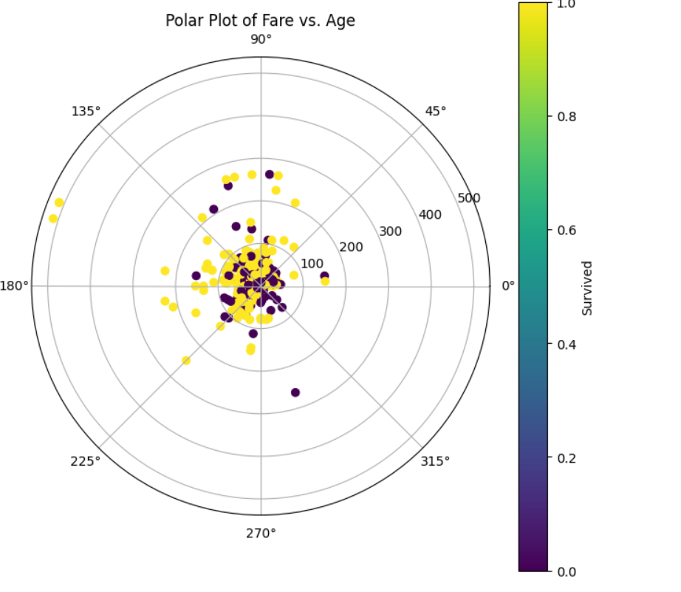

Slide 32
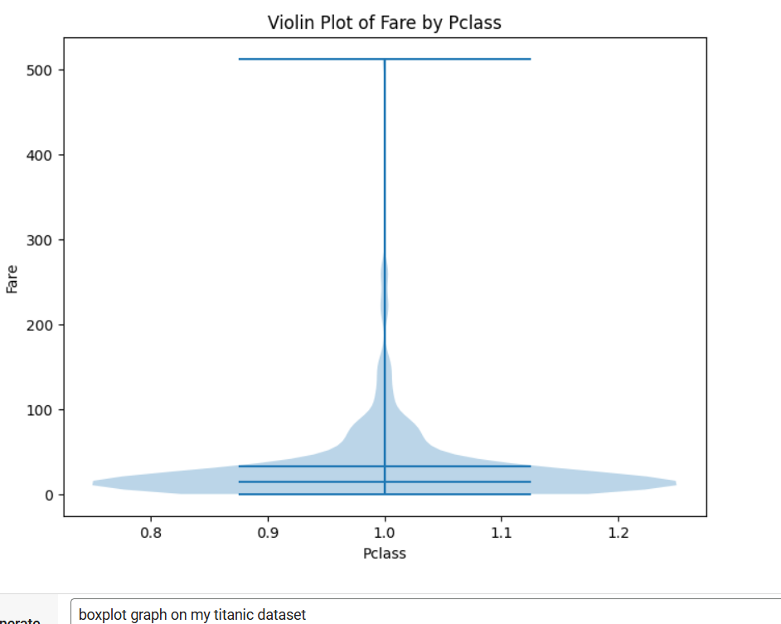

Slide 33
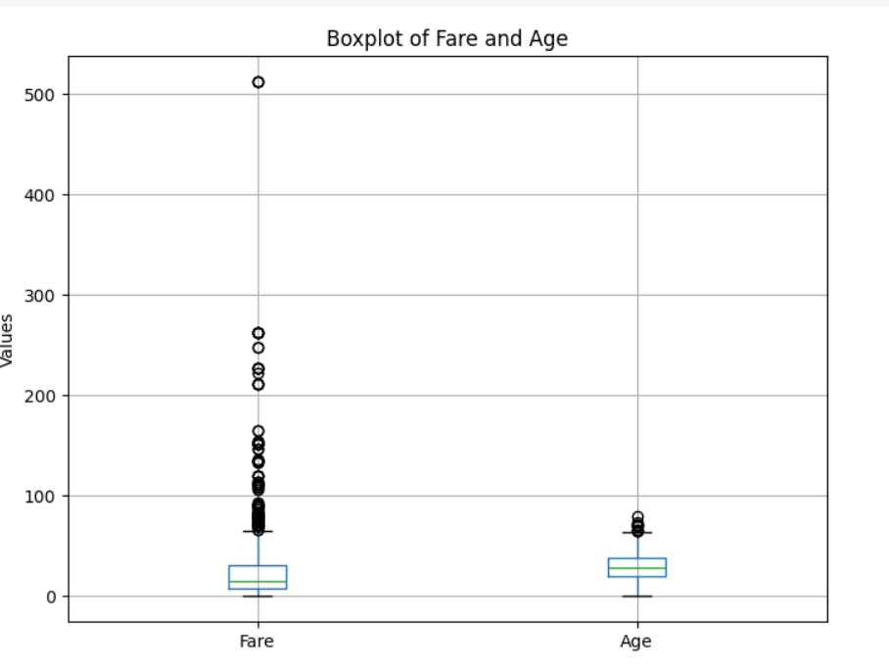

Slide 34
Conclusion
Data preprocessing is essential for model accuracy and efficiency.
Data augmentation enhances training by increasing dataset diversity.
Proper preprocessing and augmentation lead to better machine learning models.

